Slide 1
Lecture 16: Routing – I
Tsung-Wei (TW) Huang
Department of Electrical and Computer Engineering
University of Utah, Salt Lake City, UT

Slide 2
Physical Design Flow – Routing
Notes:
So far, we have talked about three important problems in physical design, partition, floorplan and placement. There is one very important step after placement, called clock tree synthesis or CTS, which we may not have enough time to talk about. But the essential idea is very similar to routing, you know, we want to establish connection between placed cells but only for sequential elements.
So, today, we are going to talk about routing. A very important step after placement. This is probably the most difficult part in the entire physical design flow, not just because of its problem difficulty but also its computational complexity.

Slide 3
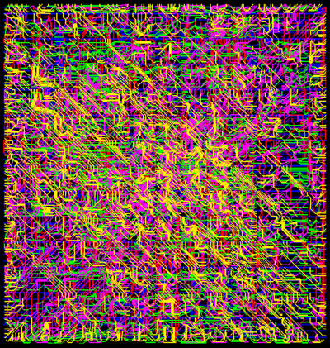
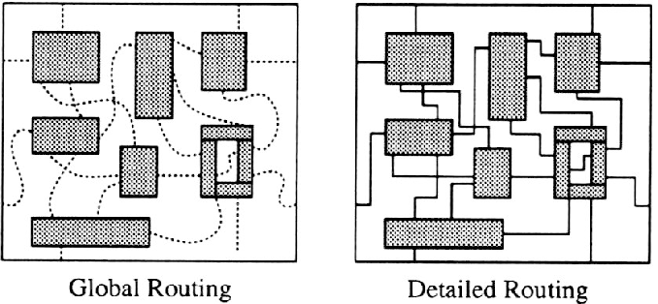
Routing Problem
Notes:
Simply put, the objective of routing is to establish wire connection among placed cells or gates. You know, after placement, you have all cell locations, some cells are sitting on the lower left while others are sitting on the upper right. The next goal is to connect all the cells that reside in a net so they can talk to each other by sending signals.
(click) Similar to placement, where we have global placement, detailed placement, and legalization, people tackle the big routing problem in two levels, global routing and detailed routing. Global routing decides the rough connection for each net, like in this picture, I can understand this gate is probably, maybe, connecting to its friend by going along the right direction. And this gate, maybe should go to its friend along the left direction, and so on so forth. Nothing is really connected yet after the global routing, just like the output of global placement.
Detailed routing decides the exact connection for each net based on the estimate of global routing. Here, we really need to know the exact route for each connection. This is the solution that we will pass on to the next stage.
(click) Here, I am showing you a picture of a routing on a chip (explain)

Slide 4
Challenges of Routing
Scale
Big chips have an enormous number (millions) of wires
Not every wire gets to take an “easy” path to connect its pins
Must connect them all--can’t afford to tweak many wires manually
Geometric complexity
It used to be representing the layout was a simple “grid”
No longer true: at nanoscale, geometry rules are complex – makes routing hard
Electrical complexity
It’s not enough to make sure you connect all the wires
Must ensure delays thru the wires are not too big
And wire-to-wire interactions (crosstalk) don’t mess up
Notes:
Why is routing challenging? First of all, it is the scale. (explain …)
Second, it’s the geometric complexity. (explain …)
Finally, we need to consider electrical complexity.

Slide 5
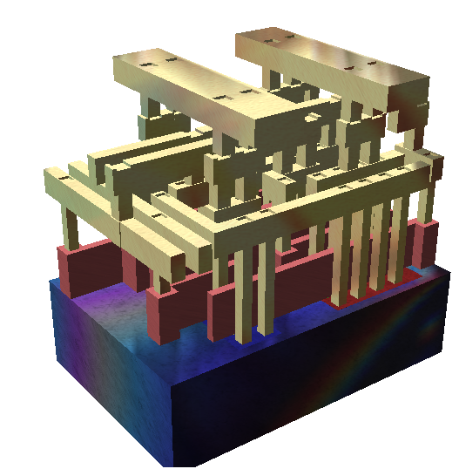
Physical Assumptions
Many layers of wires
Made of metal (today, copper)
We can connect wires in different layers with vias
A simplified view
Standard cells are using metal on layers 1,2
Routing wires on layers 3-8
Upper layers (9, 10) reserved for power and clock distribution (e.g., clock tree network)
Wikipedia: search “standard cell”
http://en.wikipedia.org/wiki/File:Silicon_chip_3d.png
Notes:
There are also a lot of physical assumptions. Many layers of wires, you know, made of metal, and we connect wires in different layers with vias. A via is a special metal that allows you to send signal vertically between different layers, in addition to the regular horizontal plane of wires.
A simplified view of the physical assumption is that (explain)
But, of course, depending on your manufacturing process, you may have different physical assumptions.

Slide 6
Placement vs Routing
There are lots of different placement algorithms
Iterative methods. Used mainly for high-level floorplanning, not gate layout
Many analytical methods based on solving/optimizing large systems of equations
There are not quite so many routing algorithms
There are lots of routing data structures – to represent the geometry efficiently
But there is one very, very big idea at core of most real routers
Notes:
If you compare routing with placement, you will realize there are a lot of different placement algorithms. You know, we have spent five lectures talking about placement algorithm, starting from the iterative methods to SA-based optimization, then to quadratic placement optimization, and to nonlinear placement algorithm.
There are also many analytical methods based on solving and optimizing large systems of equations. You know, we have talked about conjugate gradient method to solve quadratic placement and nesterov’s method to solve nonlinear placement problem.
On the routing front, there are not quite so many algorithms. You know, there are a lot of routing data structures to represent the geometry constraint and layout efficiently. But there is one very very big idea at the core of most real routers.

Slide 7
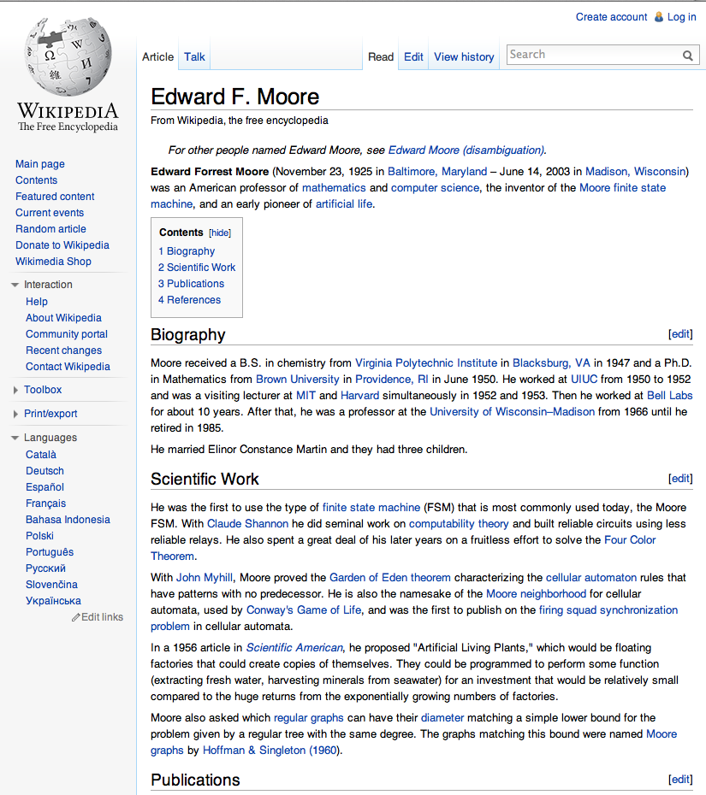
Big Idea: Maze Routing
From one famous early paper:
E.F. Moore. “The shortest path through a maze,” International Symposium on the Theory of Switching Proceedings, pp 285--292, Cambridge, MA, Apr. 1959. Harvard University Press
Given a maze (or a graph), find a shortest path from entrance to exit
Yes – it’s that Moore of “Moore state machines” fame
Notes:
That big idea is maze routing. It is named after this very famous paper by Dr. Moore, “The …”.
It solves the problem of given a maze or a graph, find a shortest path from a source location to a targe location.
And, yes, you probably learnt the finite state machine, the Moore state machine. That’s the same person.

Slide 8
How Do We Get from “Mazes” to “Wires”?
Make a big geometric assumption: Gridded routing
The layout surface is a grid of regular squares
A legal wire path = a set of connected unobstructed grid cells
For us: wires are also strictly horizontal and vertical. No diagonal (eg, 45º) angles. A path goes east/west, or north/south, in this grid.
T
obstacle
N
W
E
S
S
Notes:
How do we get from maze to wire? It is based on a big geometric assumption, gridded routing. (explain …)

Slide 9
Grid Assumptions
This is a critical assumption implying constraints on wires
All wires are the same size (width)
All pins we want to connect are also “on grid” ie, center of grid cell
Wires and their vias fit in the grid, without any geometry rule (eg, spacing) violations
Via
Layer K
Layer
K+1
Notes:
Again, like placement, this grid-based assumption is not realistic but it gives us a systematical way to approximate the original problem and allows us to come up with efficient computational methods to solve the routing problem.
The grid model is a critical assumption that implies constraints on wires. (explain …)

Slide 10
Maze Router: Strategy
Strategy
One net at a time: completely wire one net, then move onto next net
Optimize net path: find the best wiring path
Problems
Early nets wired may block path of later nets
Optimal choice for one net may block later nets
We are just going to ignore this one for the moment …
Notes:
With this grid-based model, we can develop our maze router or the maze routing algorithm. The strategy is as follows: We handle one net at a time, completely wire one net and then move onto the next net. More importantly, we will optimize net path by finding the best wiring path. Often, this means finding the shortest path between two nodes.
But there are some problems. (explain …)

Slide 11
Maze Router: Basic Idea for 2-pin Net
Given:
Grid - each square cell represents where one wire can cross
A source (S) and target (T)
Objective:
Find shortest path connecting source cell (S) and target cell (T)
When using cells, a wire can:
S
T
cross or bend
Notes:
Now, let’s take a look at how maze router works for a simple 2-pin net. A net that connects to only two pins. The problem is the following: we are given a grid, (explain …)
The objective is to (explain …)

Slide 12
Maze Router: Expansion
S
Start at the source
Find all new cells that are reachable
at pathlength 1, ie, all paths that are just 1 unit in total length (just 1 cell) - mark all with this the pathlength
1
Repeat the expansion until the target is found!
2
Using the pathlength 1 cells,
find all new cells which are reachable at pathlength 2
2
1
2
2
Notes:
The key idea behind maze routing is the expansion process. You start at the source node, ok, (click), then you find all … (click) …

Slide 13
Maze Router Walkthrough – I
Strategy
Expand one cell at a time until all the shortest paths from S to T are found.
Expansion creates a wavefront of paths that search broadly out from source cell until target is hit
Remember this!? We have done this using breadth-first-search (BFS) algorithm!
3
2
3
4
5
6
2
S
1
2
3
4
5
3
2
3
4
5
6
4
3
4
5
6
7
5
4
5
6
T
7
6
5
6
7
Notes:
Let’s walk through the algorithm using a simple. Here I have a 6 by 6 grid that models the routing problem in a 2D layout. Here, I have my source location and my target location. The goal is to establish a shortest route from the source location to the target location.
We know the strategy of maze routing is (explain …)

Slide 14
Maze Router Walkthrough – II
Now what? Backtrace
Select a shortest-path (any shortest-path) from target back to source
Mark its cells so they cannot be used again – mark them as obstacles for later wires we want to route
Since there are many paths back, optimization information can be used to select the best one
Here, just follow the pathlengths in the cells in descending order
3
2
3
4
5
6
2
S
1
2
3
4
5
3
2
3
4
5
6
4
3
4
5
6
7
5
4
5
6
T
7
6
5
6
7
Notes:
After we hit the target during the course of the expansion, we can stop since we find a shortest route. Now what? We need to find one path that connects S to T, right? We can do this by backtrace. (explain first item and the figure)

Slide 15
Maze Router Walkthrough – III
Now what? Clean-up
Clean up the grid for the next net, leaving the S to T path as an obstacle
Now, ready to route the next net with the obstacles from the previously routed net in place in the grid
S
T
Notes:
After we decide a path between S and T, we will do a clean-up step. We clean up the grid for the next routing problem by leaving the S to T path as an obstacle. Why? (ask student)
Now, we are ready to route the next net with the obstacles from the previously routed net in place in the grid.

Slide 16
Maze Router Walkthrough – IV
Also called “Blockages”
Any cell you cannot use for a wire is a an obstacle or a blockage
There may be parts of the routing surface you just cannot use
But most importantly, you label each newly routed net as a blockage
Thus, all future nets must route around this blockage
S
S
T
T
Notes:
This path marked in black is also called blockages. (explain…)

Slide 17
Classical Maze Router
Expand
Breadth-first-search to find all paths from source to target
Backtrace
Walk shortest path back to the source and mark path cells as used
Clean-Up
Erase all distance marks from other grid cells before next net is route.
Notes:
To summarize the classical maze router, we have the following three steps iterating over all routing problems. First (explain …)

Slide 18
Problems of Maze Router
Storage
Do we need a really big grid to represent a big routing problem?
What information is required in each cell of this grid?
Complexity
Do we really have to search the whole grid each time we add a wire?
Technology
Just 1 wiring layer? How do we do 2 layers? 3? 4? 6? 8? 10?
How do we deal with vias (connecting different routing layers?)
2 issues here
Applications of basic algorithm versus implementation issues
Notes:
What could be the potential problems of this approach? (ask students)

Slide 19
Multi-point Net
Multi-point Nets
One source → Many targets
You get this with any net that represents fanout (almost all real nets)
Simple strategy
Start: Pick one point as source, label all the others as targets
First: Use maze router to find path from source to nearest target
Note: You don’t know which one this is up front, routing will find it
Next: Re-label all cells on found path as sources, then rerun maze router using all sources simultaneously
Repeat: For each remaining unconnected target point
Notes:
More importantly, practical circuit designs are hypergraph. Each net connects to not just two points like the S and T we just modeled, right? We have many multi-point nets to route. We have one source, typically the output of a gate, connecting to many targets, many inputs of gates. This is a fact of net that represents fanout.
How can we extend our strategy here to handle multi-point net? (ask students)

Slide 20
Multi-point Net Walkthrough – I
Given:
A source and many targets
Problem:
Find a short path connecting source and targets
S
T
T
Notes:
Let’s take a look at this example of three-point net. I have one source connecting to two targets. I need to establish the routing among them.

Slide 21
Multi-point Net Walkthrough – II
First segment of path...
Run maze route to find the closest target
Start at source, go till we find any target
3
2
3
4
5
2
S
1
2
3
4
5
3
2
3
4
5
T
4
3
4
5
5
4
5
T
5

Slide 22
Multi-point Net Walkthrough – III
Second …
Backtrace and re-label the whole route as Sources for the next pass
Note – this is different
We don’t relabel the path as blockage (yet), as we did before
We label it as source, so we can find paths from any point on this segment, to the rest of the targets
3
2
3
4
5
2
S
1
2
3
4
5
3
2
3
4
5
T
4
3
4
5
5
4
5
T
5

Slide 23
Multi-point Net Walkthrough – IV
Second...
We will expand this entire set of source cells to find next segment of the net
Idea is we will look for paths of length 1 away from this whole set of sources, then length 2, 3, etc.
Go till hit another target
S
S
T
S
S
S

Slide 24
Multi-point Net Walkthrough – V
Trick
Expand from all these sources to find the shortest path from the existing route to the next target
Next: Backtrace as before
Follow pathlengths in decreasing order from target, to some source cell
3
2
3
4
5
2
S
1
2
3
4
5
2
S
1
2
3
4
T
5
2
S
1
2
3
4
5
2
S
1
S
1
2
3
4
3
2
2
3
4
5

Slide 25
Multi-point Net Walkthrough – VI
Finally
Do usual cleanup
Mark all of the segment cells as used and clean-up the grid
Now, have embedded a multipoint net, and rendered it an obstacle for future nets
S
S
1
2
3
4
T
5
S
S
S

Slide 26
Is this Strategy Optimal?
No! This strategy is NOT optimal!
Maybe surprising, but this is just a good heuristic
The optimal path has a name: called a Steiner Tree
How hard is to get the optimal Steiner Tree?
NP-hard! (i.e., computationally hard)
Yet another example of why physical design is full of tough, important problems to solve
To date, making optimal Steiner Tree is still an active research area
Parallel Steiner Tree construction algorithms
Machine learning-based algorithms
…
Notes:
Question, is this strategy optimal? (click and explain …)

Slide 27
Steiner Tree Constructions
2 so-called “Steiner-points”
EASY
HARD!
Pins to connect
Route it so we guarantee each 2-point path
is shortest; this is Minimum Spanning Tree
Redraw it--different
orientations
of 2-point paths
Now we can see the
better (shorter)
Steiner tree
Notes:
This slide shows you an example of steiner tree constructions. Assume we have a four-pin net to route, (click) an easy way is to connect them along the boundary of the enclosed bounding box of the net.
Or, (click), we can have a connection like this
(click) alternatively, we can change the solution in a way that all wires go inside the bounding box while still getting us the optimal wirelength. In this case, we may need to introduce several “bend points” or “turn points”, you know, the location you make a turn. This turn point has a special name called steiner point. Many steiner tree construction algorithms are focusing on finding the steiner points to approximate the optimal solution.

Slide 28
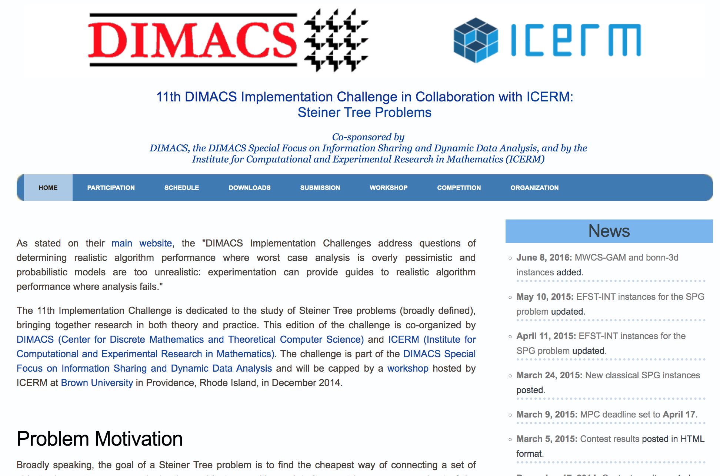
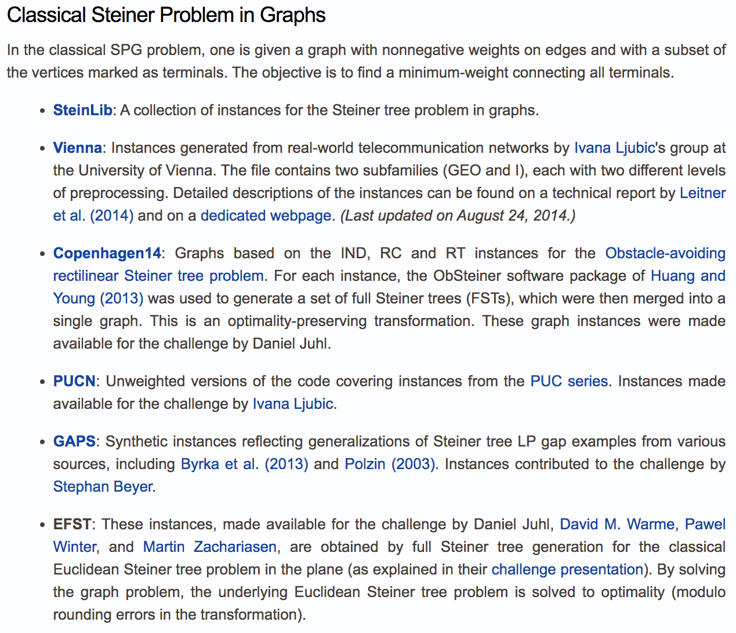
11th DIMACS Implementation Challenge
11th DIMACS Implementation Challenge in Collaboration with ICERM: Steiner Tree Problems: https://dimacs11.zib.de/home.html
Notes:
(explain …)

Slide 29
How to Handle Non-unit Grids?
Practical maze routing (routing area) are non-unit
Wires should avoid going through high-congested areas
Wires should avoid going through blocked areas
Wires should avoid going through constrained areas
…
Can we apply maze routing algorithm still?
Notes:
So far, we have been talking about routing on a uniform grid. There is no weighted connection between any pair of grid, or every grid has the same unit weight of 1. But, you know, practical maze routing are not uniform. They do not always have unit weight because of different constraints. You may want some wires go avoid going through certain area or prefer some wires going through certain area. For example, (explain …)
In this case, you want to adjust the weight of grid to control how the algorithm find shortest paths.

Slide 30
Maze Router on Non-unit Grids
Old problem
Each cell in grid costs the same to cross it with a wire
Cost ==1, unit-cost
Is this necessary? No!
Now, in practice
Given grid, Source and target
Different weights for each cell
Problem formulation
Find minimum cost path (i.e., shortest path) connecting source and target.
S
3 3 3 3
3 3 3 3
T

Slide 31
Maze Router on Non-unit Grids (cont’d)
Old problem
Each cell in grid costs the same to cross it with a wire
Cost ==1, unit-cost
Is this necessary? No!
Now, in practice
Given grid, Source and target
Different weights for each cell
Problem formulation
Find minimum cost path (i.e., shortest path) connecting source and target.
S
3 3 3 3
3 3 3 3
T

Slide 32
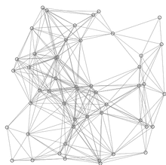
Recap: Graph Algorithm Lecture
Shortest-path-faster algorithm (SPFA)
Only perform relaxation from active vertices
Largely reduce the relaxation times
procedure SPFA(G, s)
1 for each vertex v ≠ s in V(G)
d(v) := ∞
d(s) := 0
push s into Q
while Q is not empty do
u := Q.pop()
for each edge (u, v) in E(G) do
if d(u) + w(u, v) < d(v) then
d(v) := d(u) + w(u, v)
if v is not in Q then
push v into Q
Relaxation happens only at active vertices (in queue) – largely reduced redundant relaxations!
red lines are shortest path covering blue lines are relaxations

Slide 33
From SPFA to Dijkstra Algorithm
d[s] ← 0
for each v Î V – {s}
do d[v] ← ¥
S ← ∅
Q ← V ⊳ Q Replacing the SPFA queue with min priority queue!
while Q ¹ ∅
do u ← EXTRACT-MIN(Q)
S ← S È {u}
for each v Î Adj[u]
do if d[v] > d[u] + w(u, v)
then d[v] ← d[u] + w(u, v)
p[v] ← u
Relaxation happens only at the active vertex with the minimum (shortest) value discovered so far! (i.e., vertex u)

Slide 34
Summary
We have discussed the routing problem
We have discussed 2-pin net maze routing algorithm
We have discussed n-pin net maze routing algorithm
We have discussed problems of maze routing algorithm
We have discussed optimal “Steiner Tree” router
We have discussed weighted maze routing algorithm

